Slide 1

Capstone Presentation
Edin Cobaj
July 31, 2018

Slide 2
Table of Contents
Getting to Know CoolTShirts
The User Journey
Optimizing the Campaign Budget

Slide 3
1. Getting to Know CoolTShirts

Slide 4
1.1 How many campaigns and sources does CoolTShirts use and how are they related?
There are 8 campaigns and 6 sources used by CoolTShirts
Utm_source is a website or an email that receives high traffic of potential costumers
utm_campaign is the actual promotion used to bring costumers to the CoolTShirts website
Each source uses 1 to 2 different campaigns to bring costumers to CoolTShirts

Slide 5
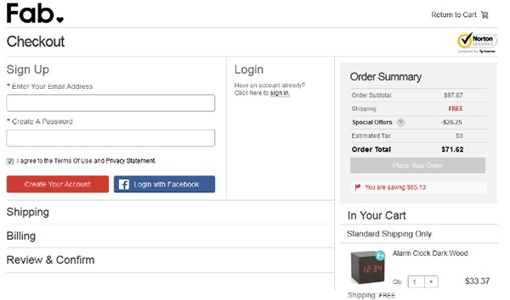
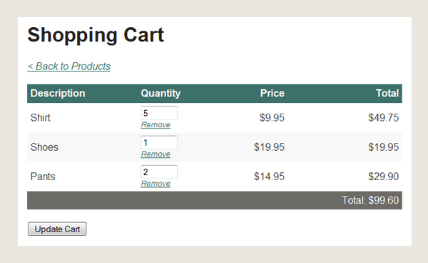
1.2 How many pages are on the CoolTShirts website?
1. Landing Page
2. The Shopping Cart
3. Checkout
4. Purchase Page

Slide 6
2. The User Journey

Slide 7
2.1 How many first touches is each campaign responsible for?
Interview with cool t-shirts founder is responsible for 622 first touches
Getting to know cool t-shirts is responsible for 612 first touches
Ten crazy cool t-shirt facts is responsible for 576 first touches
Cool t-shirts search is responsible for 169 first touches
WITH first_touch AS (
SELECT user_id, MIN(timestamp) as first_touch_at
FROM page_visits
GROUP BY user_id),
ft_attr AS (
SELECT ft.user_id,
ft.first_touch_at,
pv.utm_source,
pv.utm_campaign
FROM first_touch ft
JOIN page_visits pv
ON ft.user_id = pv.user_id
AND ft.first_touch_at = pv.timestamp
)
SELECT ft_attr.utm_source as 'source',
ft_attr.utm_campaign as 'campaign',
COUNT(*)
FROM ft_attr
GROUP BY 1, 2
ORDER BY 3 DESC;

Slide 8
2.2 How many last touches is each campaign responsible for?
Interview with cool t-shirts founder is responsible for 184 last touches
Getting to know cool t-shirts is responsible for 232 last touches
Ten crazy cool t-shirt facts is responsible for 190 last touches
Cool t-shirts search is responsible for 60 last touches
Weekly newsletter is responsible for 447 last touches
Retargeting ad is responsible for 443 last touches
Retargeting campaign is responsible for 245 last touches
Paid search is responsible for 178 last touches
WITH last_touch AS (
SELECT user_id, MAX(timestamp) as last_touch_at
FROM page_visits
GROUP BY user_id),
lt_attr AS (
SELECT lt.user_id,
lt.last_touch_at,
pv.utm_source,
pv.utm_campaign
FROM last_touch lt
JOIN page_visits pv
ON lt.user_id = pv.user_id
AND lt.last_touch_at = pv.timestamp
)
SELECT lt_attr.utm_source as 'source',
lt_attr.utm_campaign as 'campaign',
COUNT(*)
FROM lt_attr
GROUP BY 1, 2
ORDER BY 3 DESC;

Slide 9
2.3 How many last touches on the purchase page is each campaign responsible for?
Weekly newsletter is responsible for 115 last touches on the purchase page
Retargeting ad is responsible for 113 last touches on the purchase page
Retargeting campaign is responsible for 54 last touches on the purchase page
Paid search is responsible for 52 last touches on the purchase page
Ten crazy cool t-shirt facts is responsible for 9 last touches on the purchase page
Getting to know cool t-shirts is responsible for 9 last touches on the purchase page
Interview with cool t-shirts founder is responsible for 7 last touches on the purchase page
Cool t-shirts search is responsible for 2 last touches on the purchase page

Slide 10
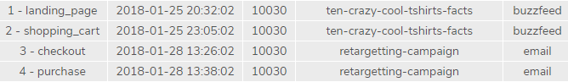

2.5 What is a typical user journey?
The user enters the site through a Buzzfeed source
The user starts on the Landing Page
The user then proceeds to the Checkout page.
The user then exits the website without making a purchase
Three days later the user receives a retargeting campaign and re-enters the site.
The user ends their journey making a purchase.

Slide 11
3. Optimizing the Campaign Budget

Slide 12
3.1 CoolTShirts can re-invest in 5 campaigns. Which should they pick?
Interview with cool t-shirts founder (First Touch – 622 Touches)
Getting to know cool t-shirts (First Touch – 612 Touches)
Ten crazy cool t-shirt facts (First Touch – 576 Touches)
Weekly newsletter (Last Touch – 447 Touches)
Re-targeting Ad (Last Touch – 443 Touches)
WHY?
CoolTShirts should re-invest in the above 5 campaigns. The first three listed were chosen because they have the most first touches of all the campaigns and will bring more users the site to begin the user journey. The last two listed campaigns were chosen because they have the most last touches of the user journey and most last touches on the purchase page which will result in the user’s completing the purchase.

Slide 13
Thank you!

